Slide 1
Protein | Model
PB2 | FLU+R4
PB1 | FLU+R4
PA | FLU+R5
HA | FLU+R8
NP | Q.mammal+R4
NA | FLU+R5
M1 | Q.mammal+R3
NS1 | HIVw+R6
Protein | Avian | Mammal
PB2 | 338 | 561
PB1 | 303 | 255
PA | 282 | 415
HA | 1406 | 919
NP | 215 | 244
NA | 185 | 207
M1 | 73 | 149
NS1 | 539 | 606
Protein | F1_{micro} | F1_{macro} | AUC
PB2 | 0.8431 | 0.5177 | 0.570
PB1 | 0.8074 | 0.3840 | 0.527
PA | 0.8750 | 0.5749 | 0.575
HA | 0.7699 | 0.2947 | 0.558
NP | 0.8840 | 0.4957 | 0.556
NA | 0.7349 | 0.3321 | 0.527
M1 | 0.8632 | 0.5168 | 0.559
NS1 | 0.9098 | 0.5188 | 0.565
Table 1: Evolutionary models attributed to each protein.
Table 2: Protein sequences that differ more than 5% in sequence identity. These were used for both phylogenetic and ML models.
Table 3: Machine Learning accuracy statistics, calculated from confusion matrices where the predicted origin host was compared against the known host of origin.

Slide 2
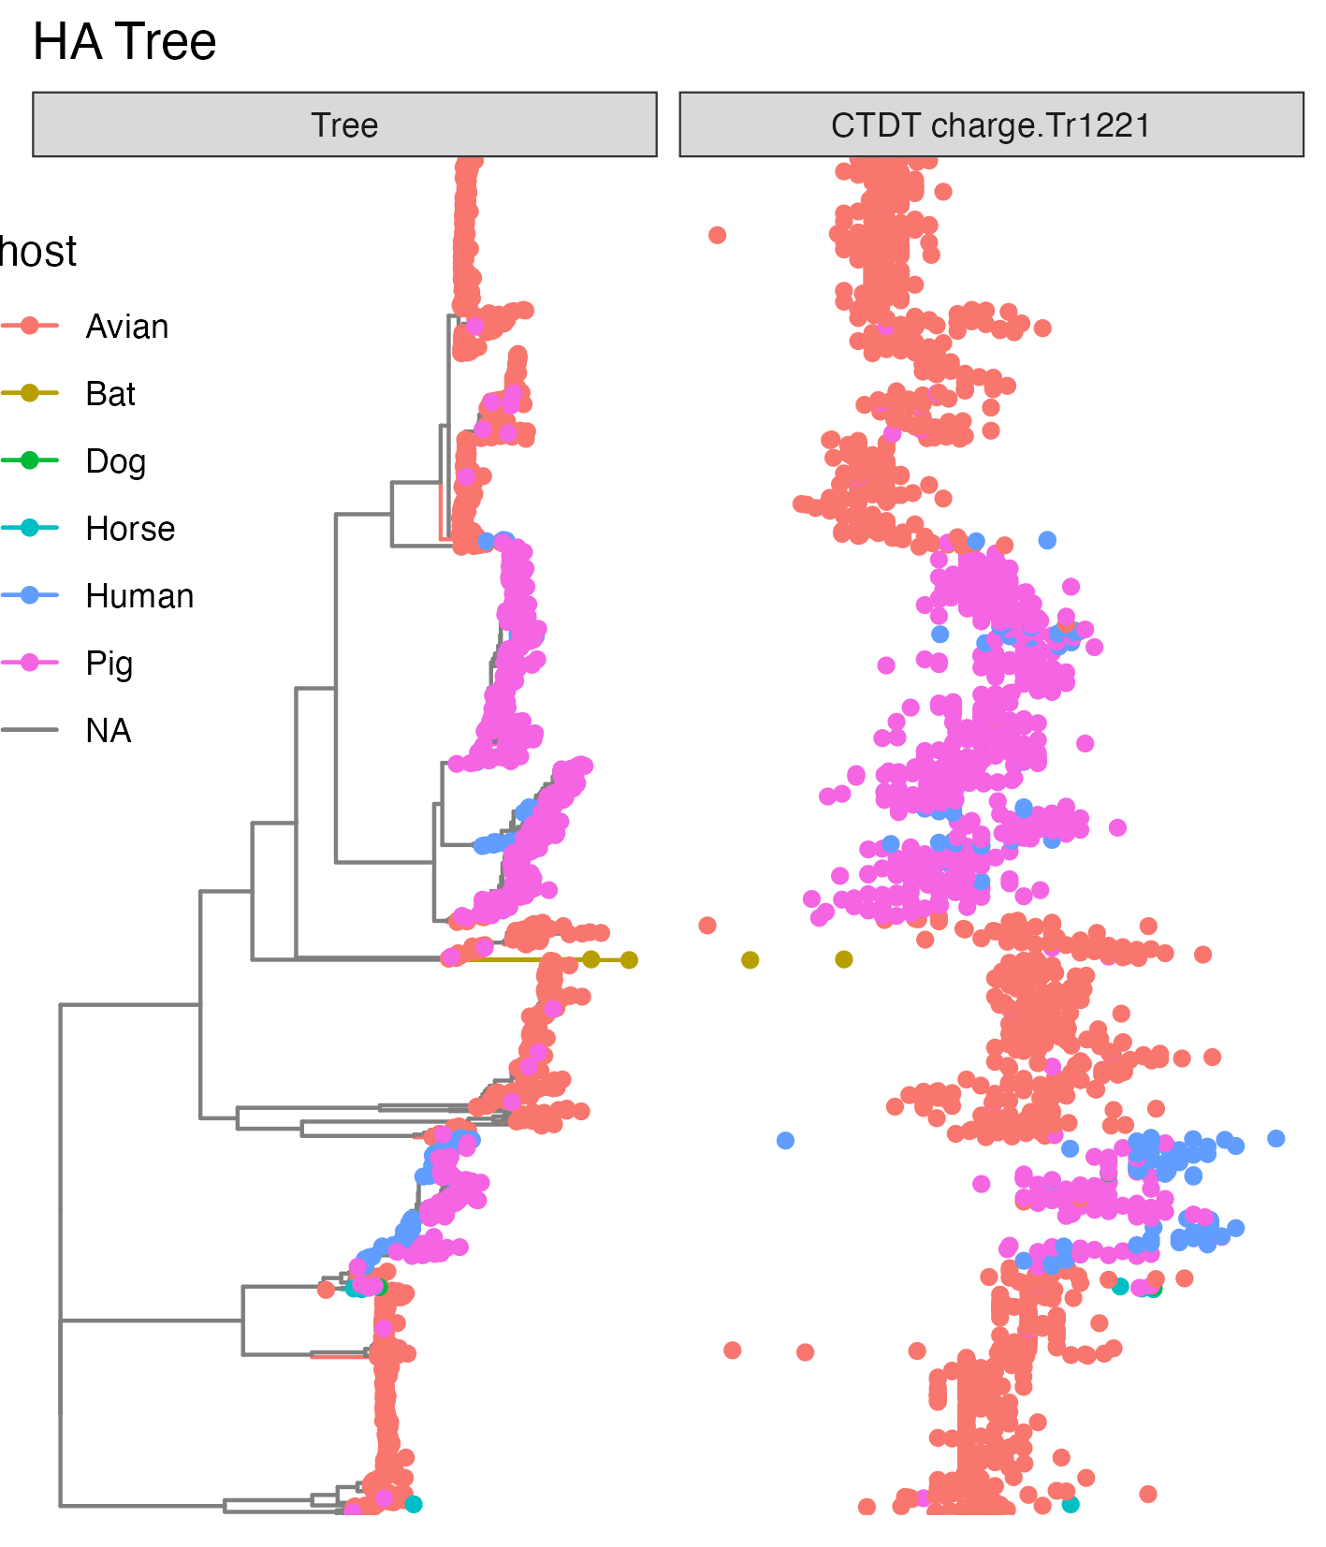

Slide 3
Model Type
(2)
Protein
(8)
Protein Feature Dataset (6)
Virus Subtype Group (26)
Two-class
Multi-class
PB2
PB1
PA
HA
NP
NA
M1
NS1
CTDc (39)
CTDd (195)
CTDt (39)
DPC (400)
PAAC (23)
Ctriad (343)
H10N7
H16N3
H17N10
H18N11
H1N1
H1N2
H3N2
H3N6
H3N8
H4N2
H4N6
H5N1
H5N2
H5N3
H5N5
H5N6
H5N8
H6N1
H6N2
H6N6
H7N1
H7N3
H7N7
H7N9
H9N2
Misc.

